Slide 1

Online Library Management
INTERNET & WEB
TECHNOLOGY
510817022 Shounak Chatterjee 510817001 Soumyajay Das 510817020 Anindya Kundu

Slide 2

STATEMENT
A consistent cloud-based scalable solution for the inventory management and lending schemes of a library.
Cardinal and salient features.
Inventory discovery.
Borrowing rules and constraints.
Account maintenance for defaulters.
Notification system.
INTERNET & WEB
TECHNOLOGY

Slide 3

CONCEPT OF OPERATIONS
Quirks and building blocks
INTERNET & WEB
TECHNOLOGY

Slide 4
BUSINESS RULES
Behaviour, guidelines, and configuration.
Foreground
Background
Authentication (pre-registered).
REGEX-based lookup of inventory.
Borrow a publication (limit enforcement).
Transfer ownership.
Resolve outstanding.
Notification (by mail).
Key-store.
“do”
ACID transaction (from message queue).
“do”
“do”
cron job.
INTERNET & WEB
TECHNOLOGY

Slide 5
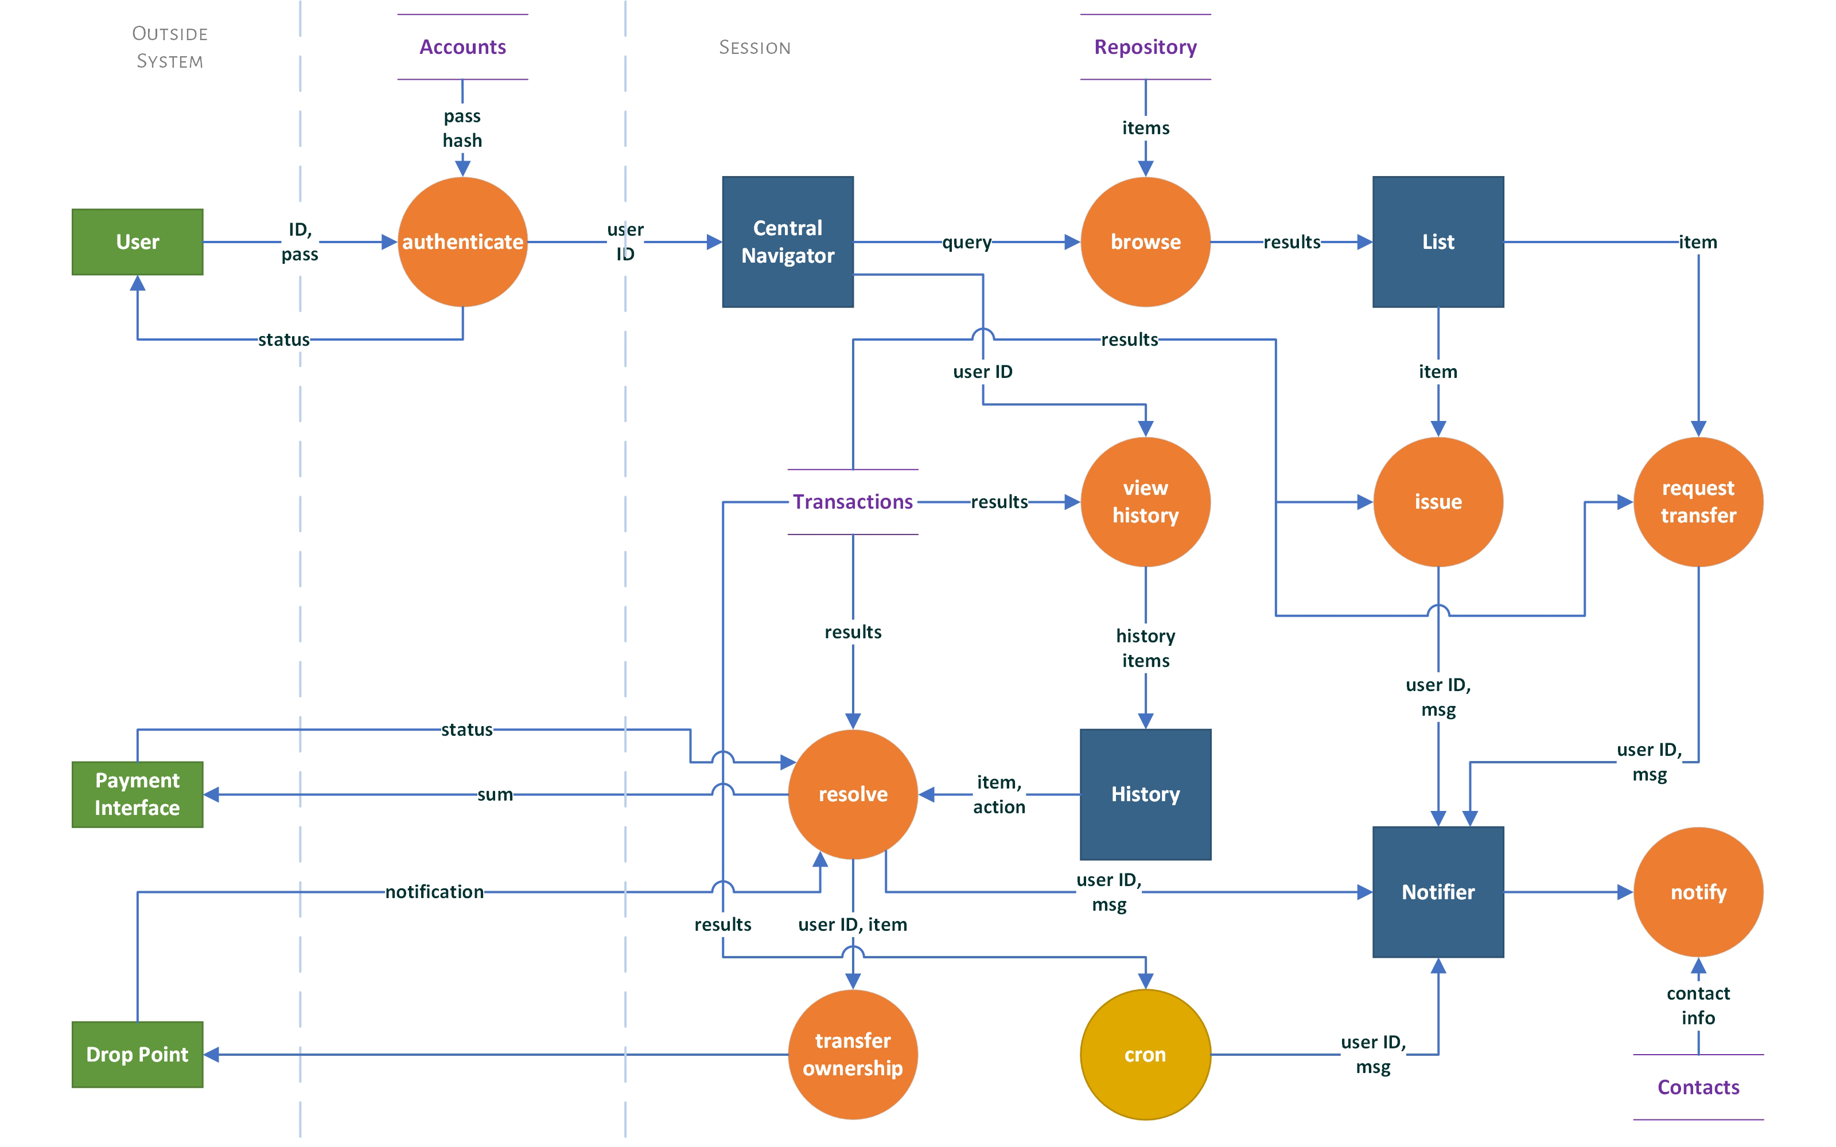
DATA FLOW DIAGRAM
INTERNET & WEB
TECHNOLOGY

Slide 6
ADMINISTRATOR Privileges
Under level system manager roles.
Manager
System Admin
Create User.
Create Publications.
Modify User Access.
Override Transactions.
Manual Notification.
Maintain DB Clusters.
Version Control.
Schema Modification.
Manage cron & notifier.
INTERNET & WEB
TECHNOLOGY

Slide 7
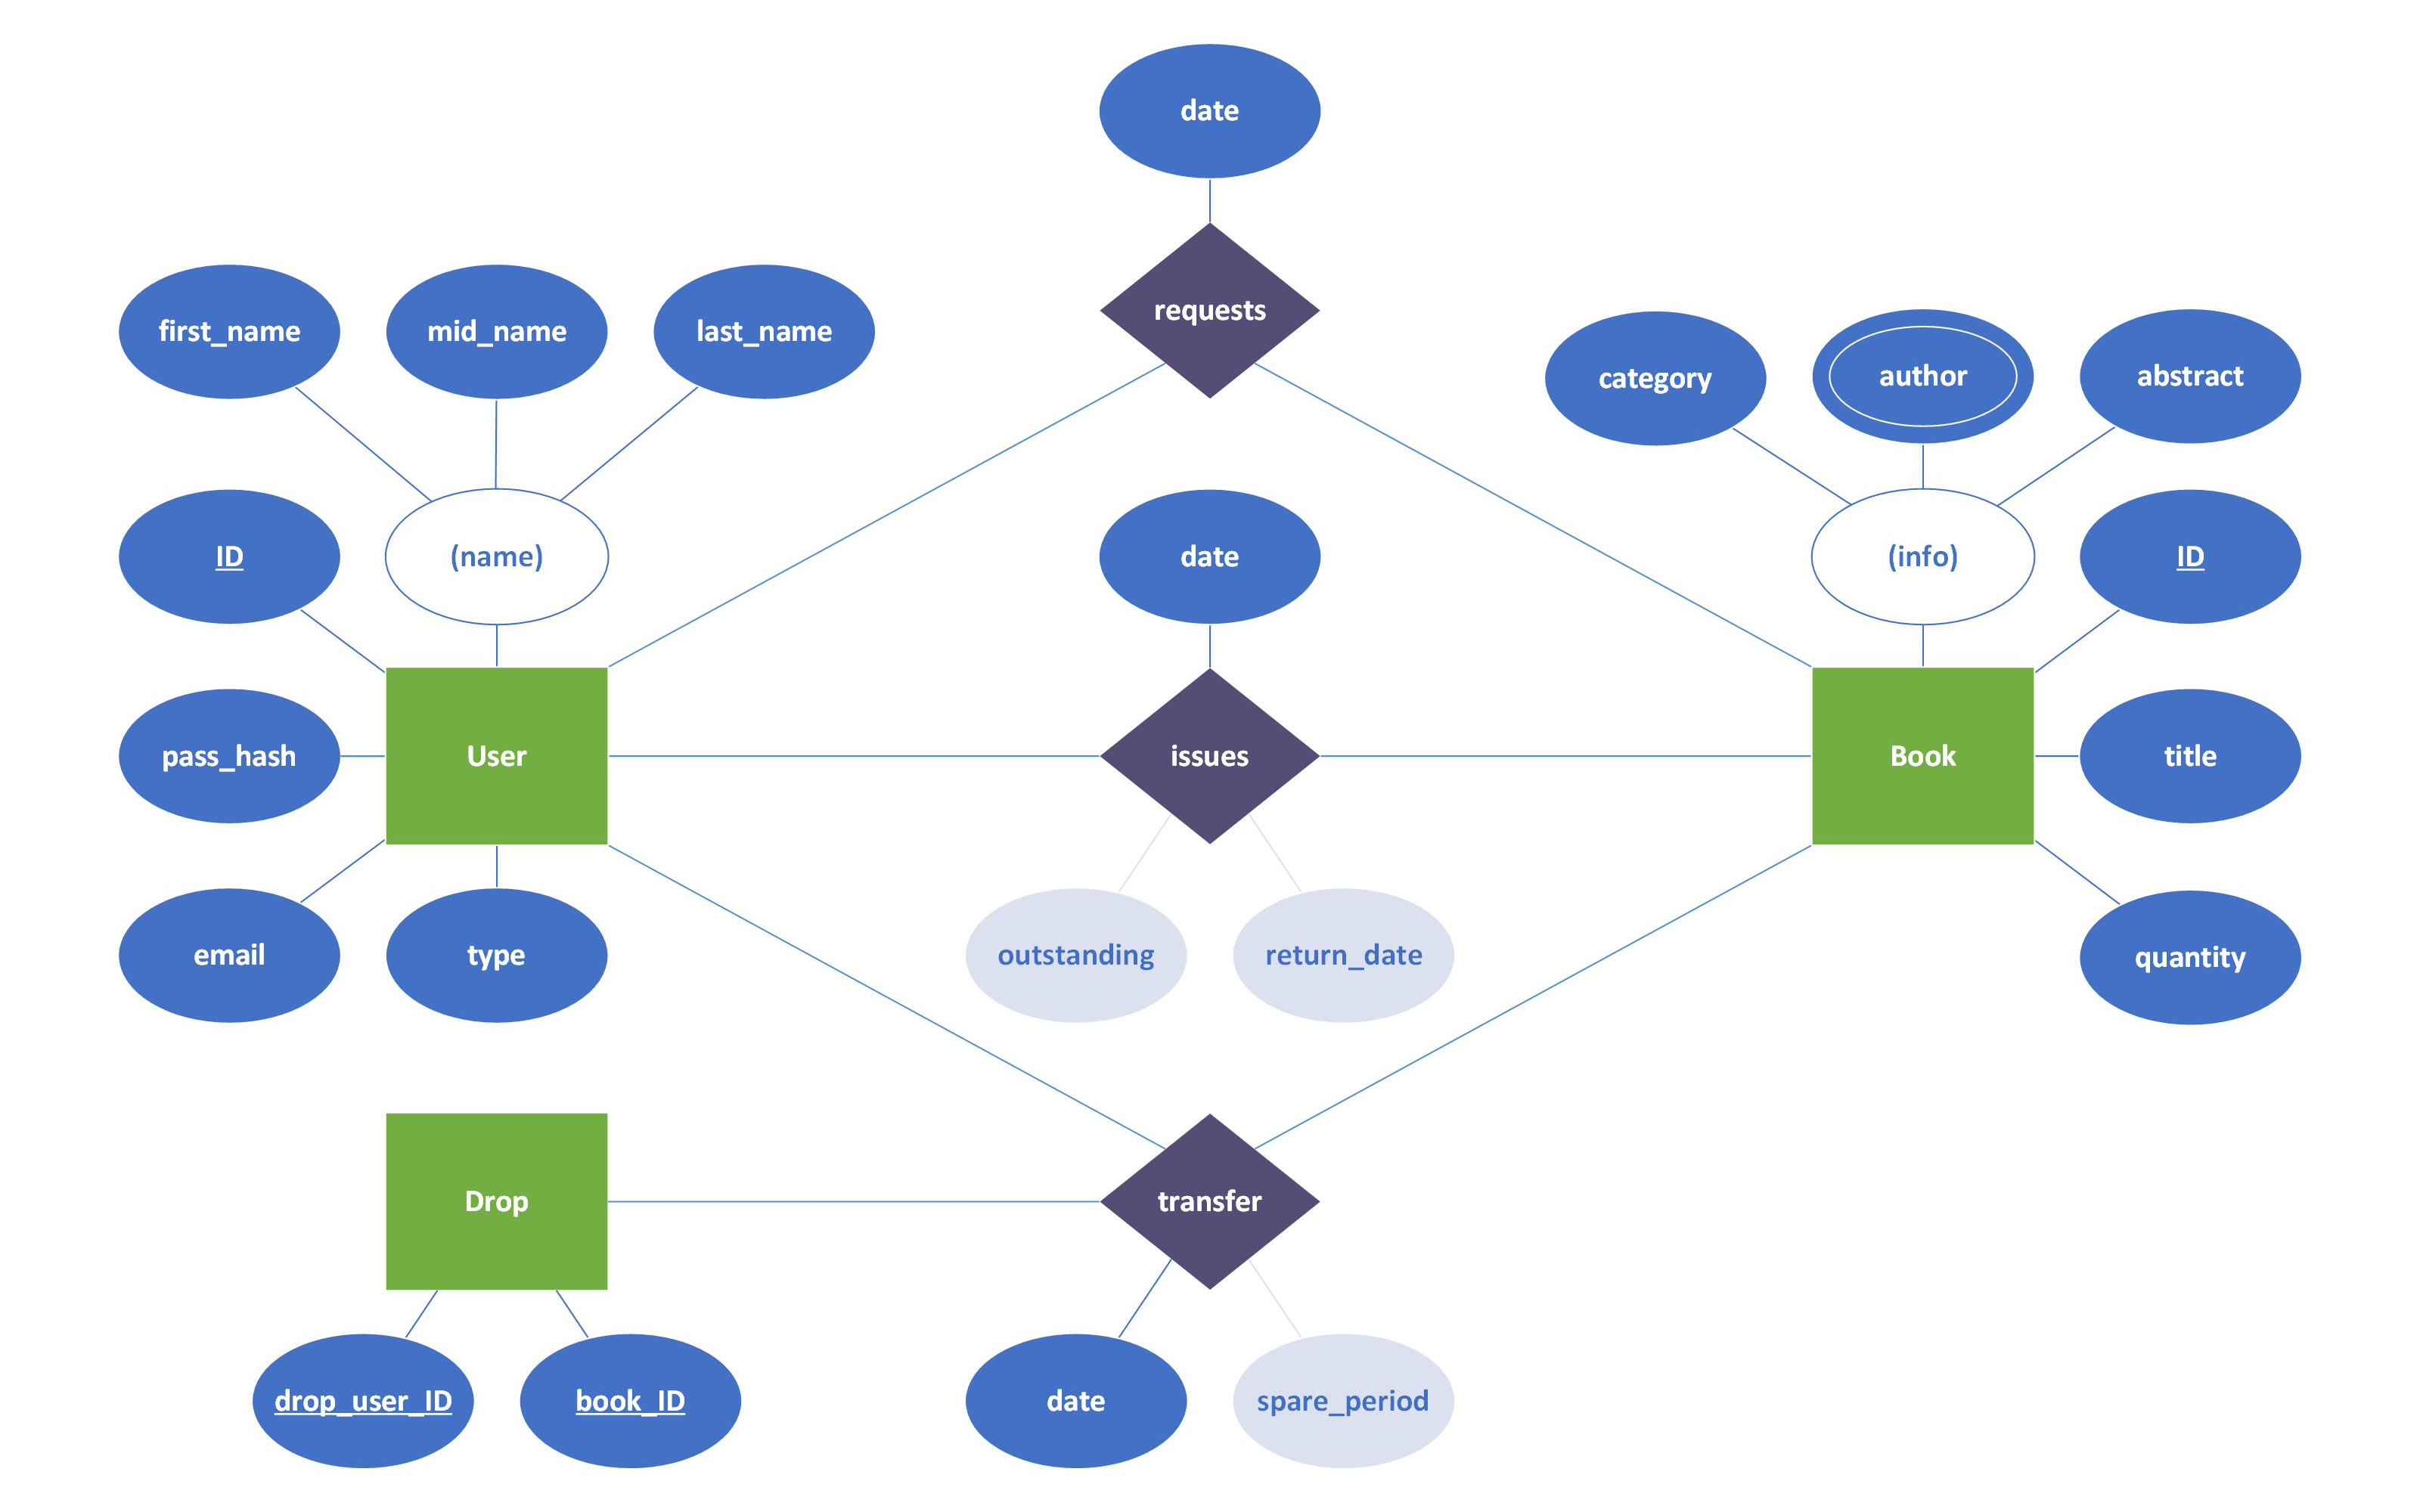
ENTITY RELATION DIAGRAM
INTERNET & WEB
TECHNOLOGY

Slide 8
SYSTEM GOALS
Prominent attribution of a scalable, consistent, non-distributed, responsive, platform.
Operation Units.
Frontend Server (for web client).
API Service.
Message Queue (mono pub-sub).
Transaction Manager (enforce ACID).
Cloud DB Unit.
INTERNET & WEB
TECHNOLOGY

Slide 9
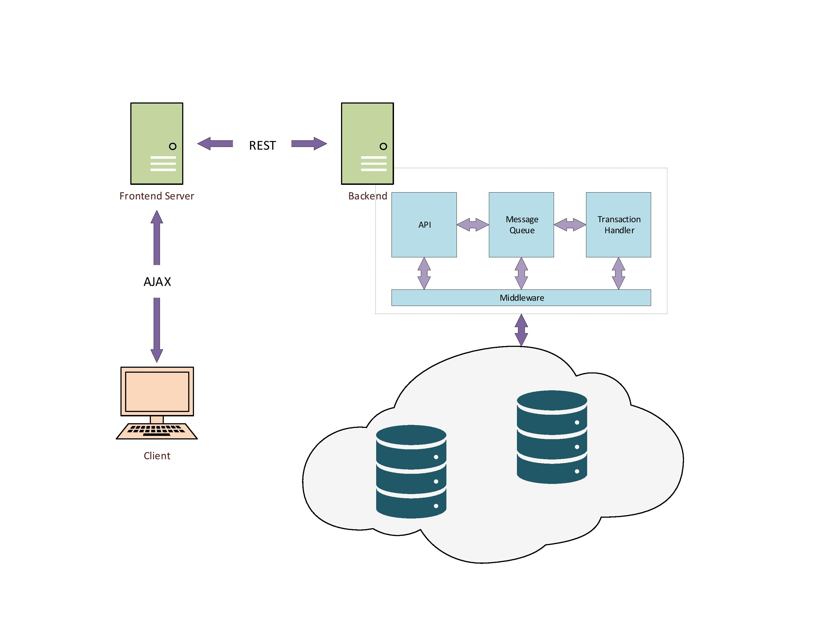
SIMPLIFIED SYSTEM DESIGN
INTERNET & WEB
TECHNOLOGY

Slide 10
APPLICATION PROGRAMMING INTERFACE
Overlying exhaustive REST API.
Query
Mutation
Auth
Users
Books
History
Notifications
borrowBook
returnBook
transferBook
resolveTrans
createUser
createBook
INTERNET & WEB
TECHNOLOGY

Slide 11
TECHNOLOGIES AND TOOLS
Languages, frameworks, libraries, and development tools
INTERNET & WEB
TECHNOLOGY

Slide 12
TECH STACK
Non-exhaustive set of essential building paraphernalia.
Production Technologies
Development Tools & Apps
React 16.x with TSX (TypeScript 4)
Redux 4.x (Context API might be enough)
Syntactically Awesome Style Sheets 3
GraphQL (on Apollo)
Node 14.x
Express 4.x
RDBMS – node-postgres (Cloud SQL)
NoSQL – MongoDB Atlas (AWS)
Mongoose 5.x
RabbitMQ 3.x
Node Package Manager (npm) 6.x
Nodemon
Webpack
Node dependencies & React plugins
Docker 19.x
Docker Linux (Debian 9 Stretch) container
Postman
INTERNET & WEB
TECHNOLOGY

Slide 13

Image SLide
EVENT STAGES
Stage 1
GraphQL API identification
Backbone setup
DB clusters setup (minus postgres)
Resolver configuration
Unit testing
Stage 2
React app setup
Integration testing
Stage 3
Structural refactoring
Postgres configuration
Stage 4
Add Admin console
E2E testing
Packaging
INTERNET & WEB
TECHNOLOGY

Slide 14

DEVELOPMENT
WOODGROVE BANK
INTERNET & WEB
TECHNOLOGY
GitHub Repository
github.com/meganindya/library-management-system

